Slide 1

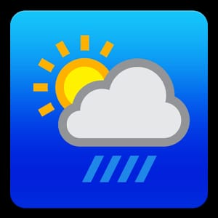
BVC Engineering College
Fetching Weather Information
Guided By
Presented by
Dr. B S N Murthy
Sishir Bohara (18-5B9)
Rupali Adhikari (18-5C0)
Devram Yadav (18-5B8)
Submitted for the partial fulfillment of
B-Tech
Computer Science and Engineering
Computer Science and Engineering
February-2022

Slide 2
Table of Content
Introduction
Literature Review
Webpage Requirement
Webpage Design
Coding
Testing
Output Screen
Conclusion
Reference

Slide 3
Introduction
Web page was introduced by Tim Berners-Lee.
A web page is a hypertext document provided by a website and displayed to a user in a web browser.
Fetching Weather Information is a web page which is used to fetch the current weather information of the City.
Can be ran on different platforms.

Slide 4
Objective and Significance
Objective
It shows the temperature in Celsius and Humidity.
It shows the condition of the Climate : cloudy, sunny, rainny etc.
Significance
The objective of our project covered are the significance of our project.

Slide 5
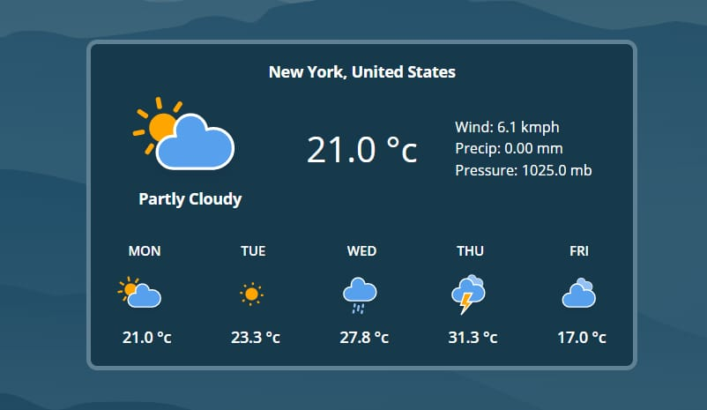
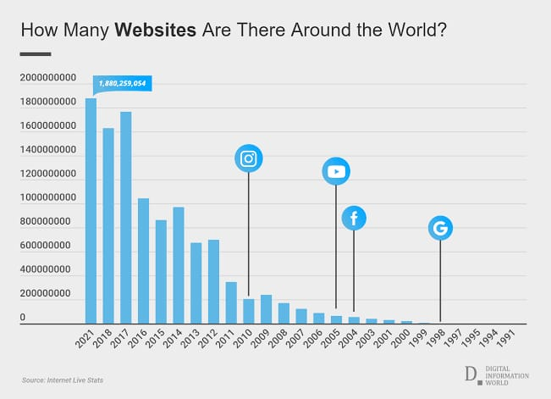
Literature Review
Weather fetching is a scope for scientific study and meteorology.
With increment in different web pages, there is increment in weather web pages too.
Like other web pages the need and uses is going to be increased accordingly.

Slide 6
Web Page Requirement
Website requirements are a list of necessary functions, capabilities, or characteristics related to website and the plans for creating it. For eg : we need utensil for cooking food. In this web page we have basically two types of requirement.
Functional requirement and
Non-functional requirement

Slide 7
Functional Requirement
Functional requirement are the function of a system or its component. A function describes as a set of inputs, the behavior and output.
Software requirement
OS : Windows/Linux/ Mac
Programming : HTML, CSS and Javascript
IDE : Visual Studio Code
Web Hosting : netlify
Hardware requirement
RAM : 512 Mb or higher
Processor : Intel Pentium 4 or higher

Slide 8
Non-functional Requirement
A non-functional requirement is a requirement that specifies criteria that can be used to judge the operation of a system, rather than specific behaviors. The following are the non functional requirement :
Performance : response time, processing time, query and reporting time etc.
Interface : good interface
Documentation : easily understandable documentation.
Portability : highly portable(used in diff platform like mobile, tablet, desktop etc.)
Quality : quality of communication.
Reliability : how reliable is project when compared to written communication.

Slide 9
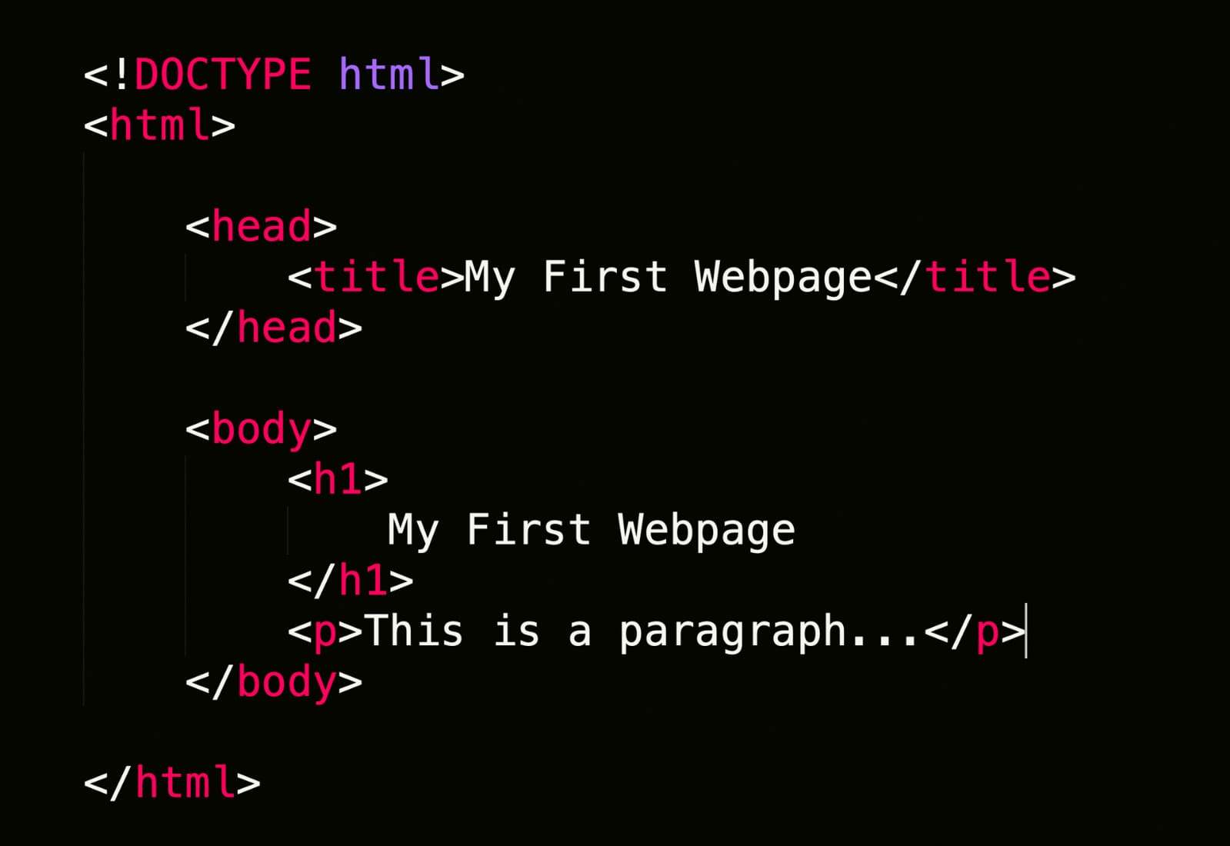
Webpage Design
Designing has always been one of the top priorities on creating anything either related to IT or non-IT. The project we created consists of different languages HTML, CSS and JavaScript.
HTML
It is hypertext markup language.
It is the standard markup language for Web pages.
It describes the structure of the web page.
It specify how text and graphics appear on a web page.

Slide 10
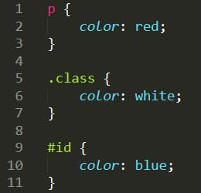
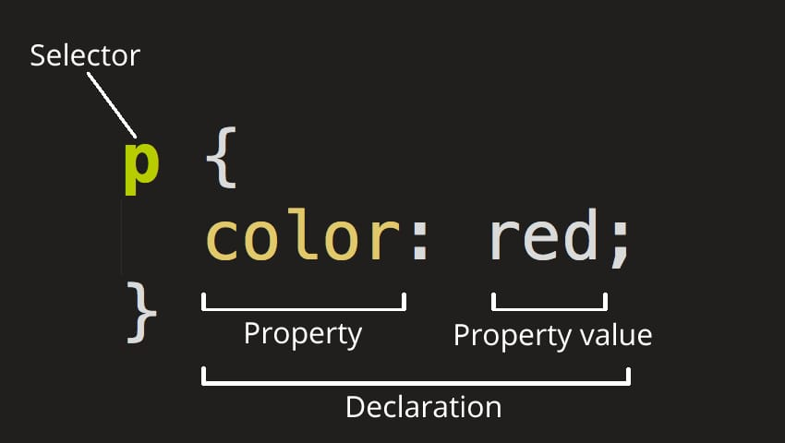
CSS
It stands for Cascading Style Sheet.
It describes how HTML elements are to be displayed on screen.
It can control the layout of multiple web pages all at once

Slide 11

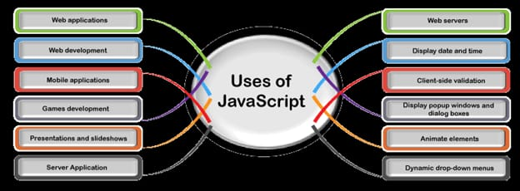
JavaScript
It is the world’s most popular programming language.
It is the programming language of the web which is lightweight, interpreted.
It is text-based programming language used both on client-site and server-site that allows we to make web pages interactive.
It is designed for creating network-centric application and it is open and cross-platform.

Slide 12
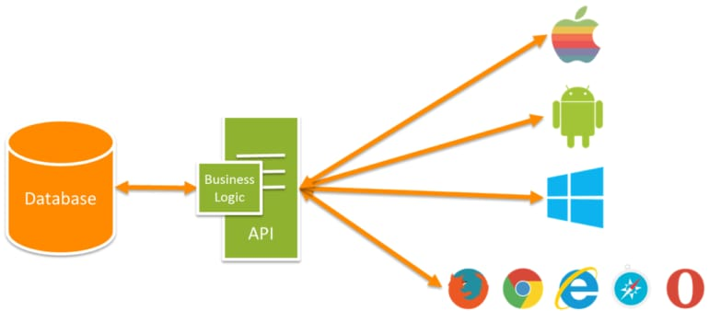
API
It is application programming interface which is used to exchange data and functionality easily and securely.
It acts as a interface between client-site and server-site.
OpenWeatherMap is an online service, owned by OpenWeather Ltd, that provides global weather data via API, including current weather data, forecasts, nowcasts and historical weather data for any graphical location.

Slide 13
Coding
HTML script to design the web page
https://github.com/sishir44/Weather_info_website/blob/main/index.html
CSS code for designing the web page
https://github.com/sishir44/Weather_info_website/blob/main/weather.css
JavaScript program to show the web page dynamically
https://github.com/sishir44/Weather_info_website/blob/main/weather.js

Slide 14
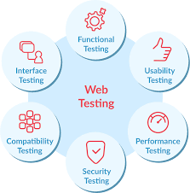
Testing
Testing is a process of executing a program with the intent of finding an error.
One of the critical element of software quality assurance and represents the ultimate review of specification, coding and testing.
A good test cause is one that has a high probability of finding an undiscovered error.
A successful test is one that uncovers an undiscovered error.

Slide 15
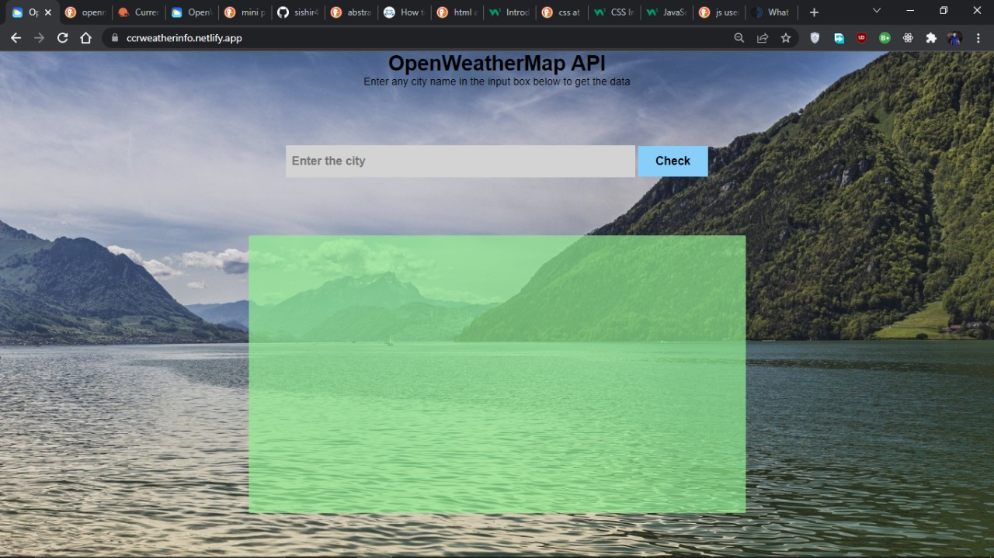
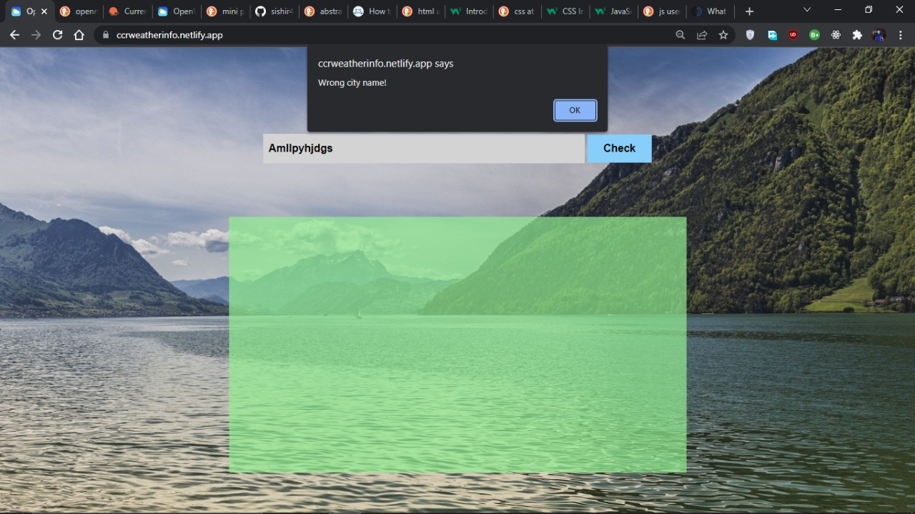
Output Screen
The following are the outputs we gain;
Wrong Input

Slide 16
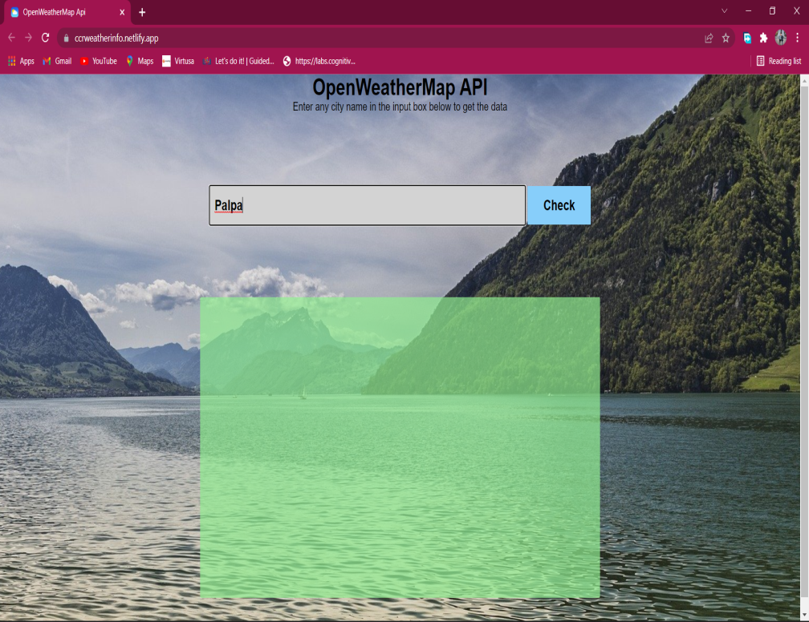
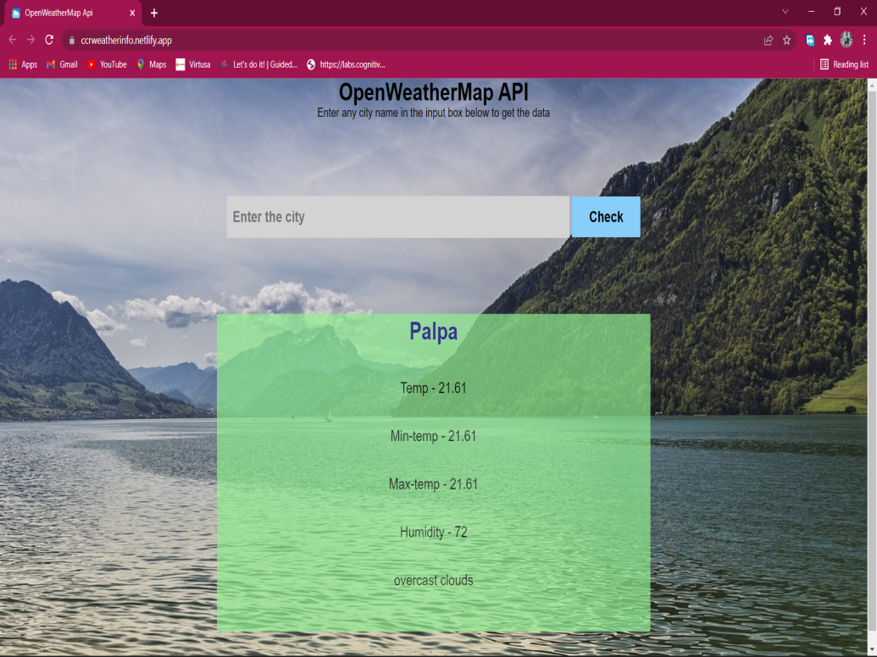
Correct Input

Slide 17
Conclusion
With the increase in technology and science the thought of connecting a programming language to work on a wide areas or sectors is not new, but its unique as it gives a new start to the connection of computer science with other many departments or subjects or any kind of literature existing in field of science today.
The increase of cost effective ideas regarding web pages is really making it forward so a lot of users are attracted towards it.

Slide 18


Reference
https://openweathermap.org/
https://www.w3schools.com/js/default.asp
https://www.w3schools.com/html/default.asp
https://www.w3schools.com/css/default.asp
https://www.weatherapi.com/

Slide 19

Any Query ???

